Slide 1
Fitness Buddy – Ai Fitness companion
IBM AICTE PROJECT
Presented By:
Student Name – Mohammad Asim
College Name – Gautam Buddha University
Department – Civil Engineering
AICTE Student ID – STU5f1895fa81d351595446778

Slide 2
OUTLINE
Problem Statement
Technology used
Wow factor
End users
Result
Conclusion
Git-hub Link
Future scope
IBM Certifications

Slide 3
Problem Statement
Many people struggle to stay consistent with fitness due to:
Lack of personalized guidance
Time-consuming research for health tips
Low motivation
Proposed Solution:
A conversational AI chatbot – Fitness Buddy – that offers:
Instant workout suggestions
Healthy meal ideas
Motivational fitness tips
Using IBM Watson Assistant Lite on IBM Cloud Lite

Slide 4
Technology Used
IBM Cloud Lite services
Natural Language Processing (NLP)
Prompt-based AI (watsonx.ai Prompt Lab)
IBM Granite foundation model
Retrieval Augmented Generation (RAG)
No custom dataset needed – prompt engineering-based

Slide 5
Wow Factor
Built entirely on IBM Cloud Lite Free Tier
No upgrades or paid plans required
Instant responses with high accuracy
Easy deployment – Web Chat / API
Customizable personality & responses
Clean UI with live chat widget support

Slide 6
End Users
🎯 Fitness enthusiasts & beginners
🎯 Busy students & professionals
🎯 Health coaches & wellness mentors
🎯 Anyone seeking motivation for a healthy lifestyle

Slide 7
Result
✅ Successfully deployed on IBM Watsonx.ai Prompt Lab
✅ Real-time interaction via Web Chat or API
✅ High-quality advice without training datasets
✅ Prompt-tuned responses with user-friendly tone
✅ Demonstrated functional working during IBM Hackathon

Slide 8
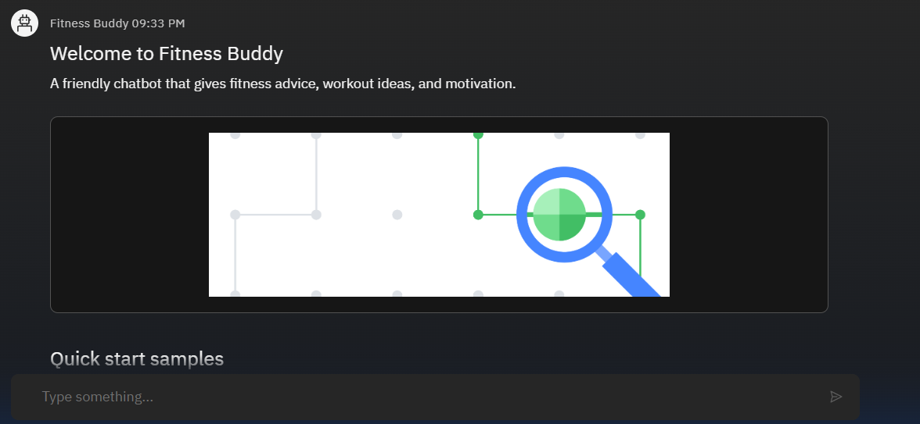
Results

Slide 9
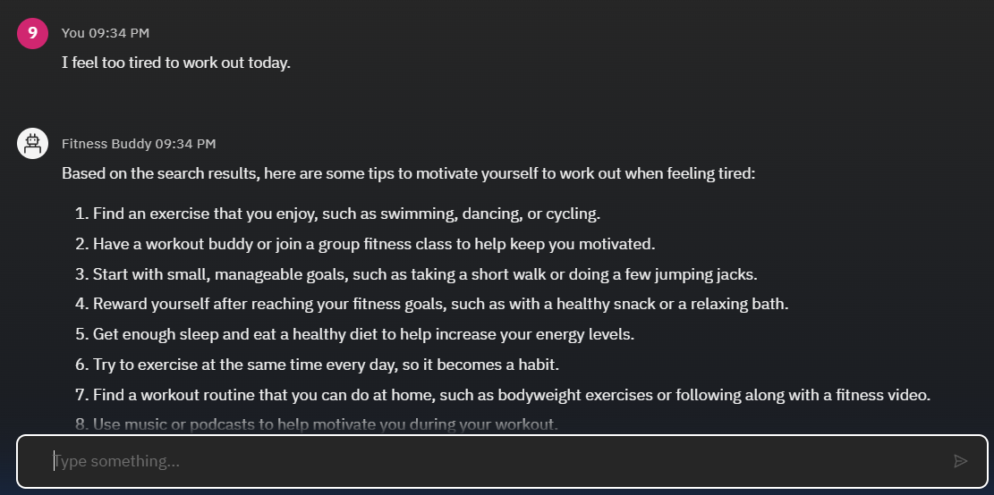
Results

Slide 10
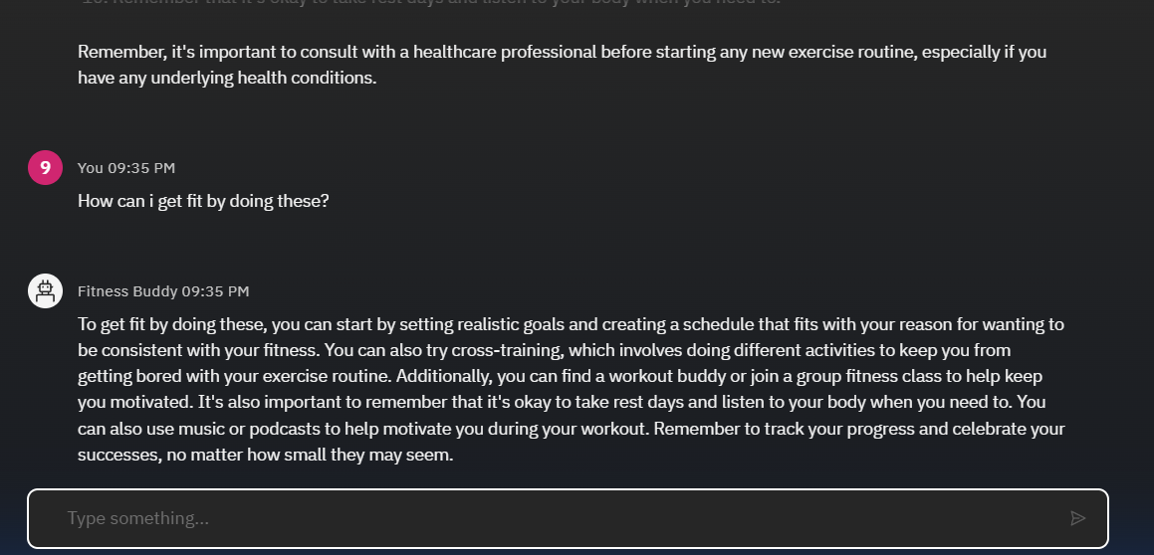
Results

Slide 11
Conclusion
Fitness Buddy demonstrates that:
Prompt engineering + Foundation Models = Powerful AI with no-code
IBM Cloud Lite enables rapid deployment at zero cost
A scalable, interactive, and accessible fitness assistant is possible without training custom models

Slide 12
GitHub Link
🔗 https://github.com/asim-git-hub/IBM-Cloud-Fitness-Buddy

Slide 13
Future Scope
🔄 Add user profile tracking for tailored plans
️ Integrate voice interaction (Speech-to-Text, Text-to-Speech)
⌚ Connect with wearable fitness devices
🌍 Include multi-language support
📚 Use RAG-based retrieval for context-rich responses

Slide 14
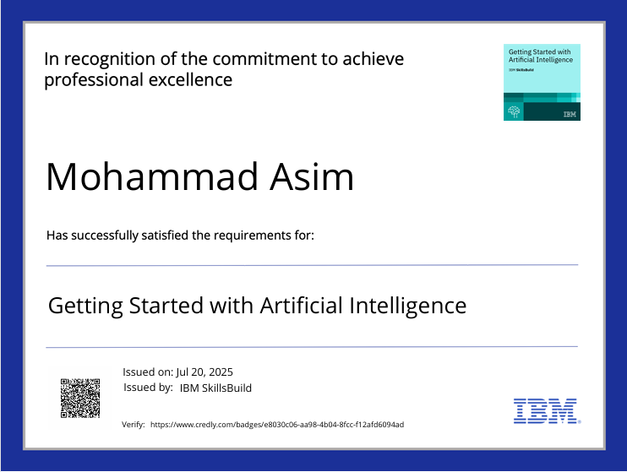
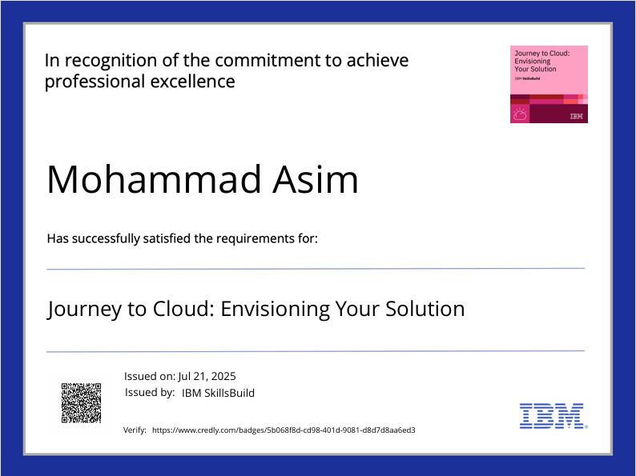
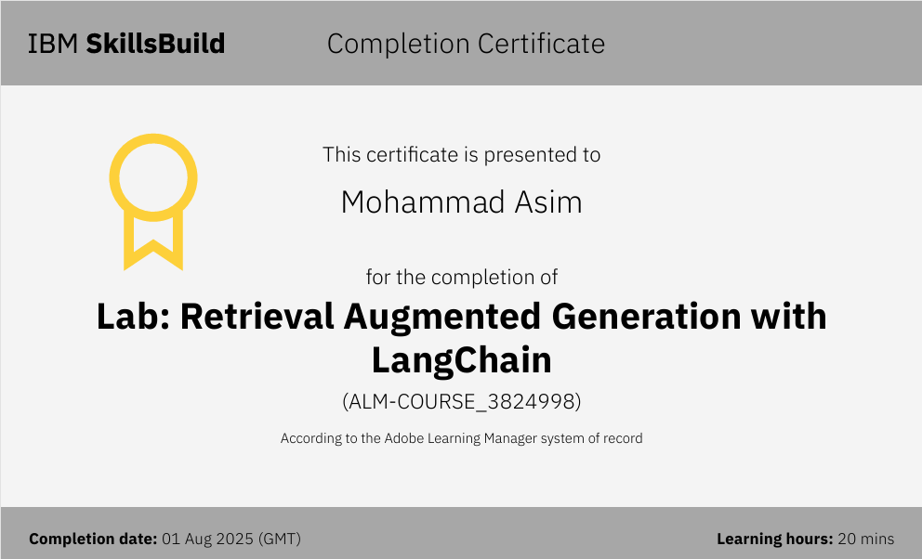
IBM Certifications

Slide 15
THANK YOU

